Slide 1
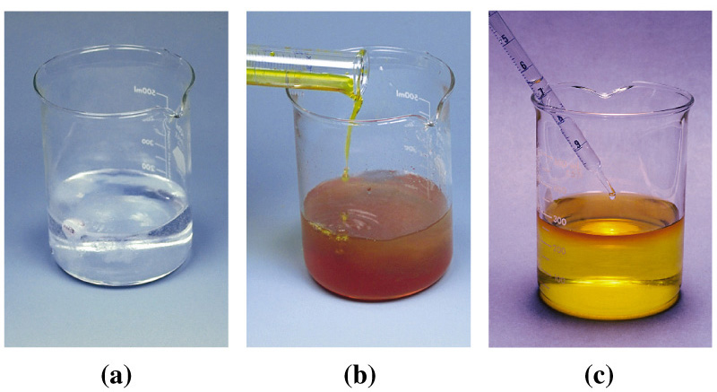
Chapter 5: Introduction to Reactions in
Aqueous Solutions
General Chemistry
Principles and Modern Applications
Notes:
Chemistry 140 Fall 2002
Iron rusts
Natural gas burns
Represent chemical reactions by chemical equations.
Relationship between reactants and products is STOICHIOMETRY
Many reactions occur in solution-concentration uses the mole concept to describe solutions

Slide 2
Contents
5-1 The Nature of Aqueous Solutions
5-2 Precipitation Reactions
5-3 Acid-Base Reactions
5-4 Oxidation-Reduction: Some General Principles
5-5 Balancing Oxidation-Reduction Equations
5-6 Oxidizing and Reducing Agents
5-7 Stoichiometry of Reactions in Aqueous Solutions: Titrations
Focus on Water Treatment

Slide 3
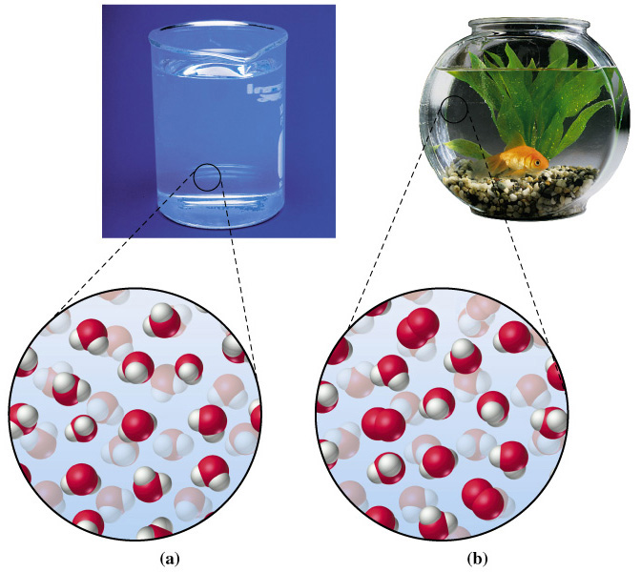
5.1 The Nature of Aqueous Solutions

Slide 4
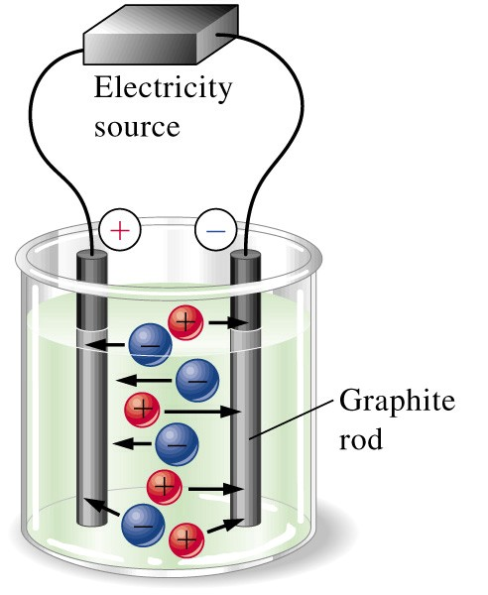
Electrolytes
Some solutes produce ions in solution, thereby making the solution an electrical conductor.
Solutes that provide ions when dissolved in water are called electrolytes.
Solutes that that do not provide ions in water are called nonelectrolytes.

Slide 5
Electrolytes
All electrolytes provide ions in water but not all electrolytes are equal in their tendencies for providing ions.

Slide 6
Types of Electrolytes
Strong electrolyte dissociates completely.
  Good electrical conduction.
Weak electrolyte partially dissociates.
  Fair conductor of electricity.
Non-electrolyte does not dissociate.
  Poor conductor of electricity.
Notes:
Chemistry 140 Fall 2002
A generalization is helpful:
Essentially all soluble ionic compounds are strong electrolytes.
Most molecular compounds are weak electrolytes or non-electrolytes

Slide 7
Representation of Electrolytes using Chemical Equations
A strong electrolyte:
MgCl₂(s) → Mg²⁺(aq) + 2 Cl⁻(aq)
A weak electrolyte:
CH₃CO₂H(aq) ← CH₃CO₂⁻(aq) + H⁺(aq)
→
A non-electrolyte:
CH₃OH(aq)
Notes:
Chemistry 140 Fall 2002
Strong – complete dissociation
Weak – reversible

Slide 8
Notation for Concentration
MgCl₂(s) → Mg²⁺(aq) + 2 Cl⁻(aq)
MgCl₂(s) → Mg²⁺(aq) + 2 Cl⁻(aq)
In 0.0050 M MgCl_{2:}
Stoichiometry is important.
[Mg²⁺] = 0.0050 M [Cl⁻] = 0.0100 M [MgCl₂] = 0 M
[Mg²⁺] = 0.0050 M [Cl⁻] = 0.0100 M [MgCl₂] = 0 M

Slide 9
Example 5-1
Calculating Ion concentrations in a Solution of a Strong Electolyte.
What are the aluminum and sulfate ion concentrations in 0.0165 M Al₂(SO₄)₃?.
Balanced Chemical Equation:
Al₂(SO₄)₃ (s) → 2 Al³⁺(aq) + 3 SO₄²⁻(aq)

Slide 10
Example 5-1
Aluminum Concentration:
0.0165 mol Al₂(SO₄)₃
2 mol Al³⁺
0.0330 M Al³⁺
[Al] = × =
1 L
1 mol Al₂(SO₄)₃
Sulfate Concentration:
0.0165 mol Al₂(SO₄)₃
3 mol SO₄²⁻
[SO₄²⁻] = × =
0.0495 M SO₄²⁻
1 L
1 mol Al₂(SO₄)₃

Slide 11
5-2 Precipitation Reactions
Some metal salts, such as NaCl, are quite soluble in water, while others, such as AgCl, are not very soluble at all.
In fact, so little AgCl dissolves in water that this compound is generally considered to be insoluble.
Ag⁺(aq) + Cl⁻(aq) → AgCl(s)

Slide 12
5-2 Precipitation Reactions
Precipitation reactions occur when certain cations and anions combine to produce an insoluble ionic solid called a precipitate.
One laboratory use of precipitation reactions is in identifying the ions present in a solution.
In industry, precipitation reactions are used to manufacture numerous chemicals.
Ag⁺(aq) + Cl⁻(aq) → AgCl(s)

Slide 13
Net Ionic Equation
Overall Precipitation Reaction:
AgNO₃(aq) +NaI (aq) → AgI(s) + NaNO₃(aq)
Complete ionic equation:
Spectator ions
Ag⁺(aq) + NO₃⁻(aq) + Na⁺(aq) + I⁻(aq) →
AgI(s) + Na⁺(aq) + NO₃⁻(aq)
Ag⁺(aq) + NO₃⁻(aq) + Na⁺(aq) + I⁻(aq) →
AgI(s) + Na⁺(aq) + NO₃⁻(aq)
Net ionic equation:
Ag⁺(aq) + I⁻(aq) → AgI(s)

Slide 14
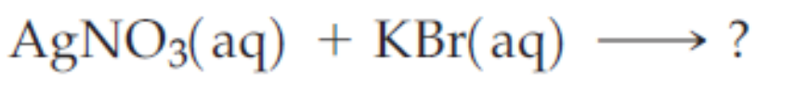
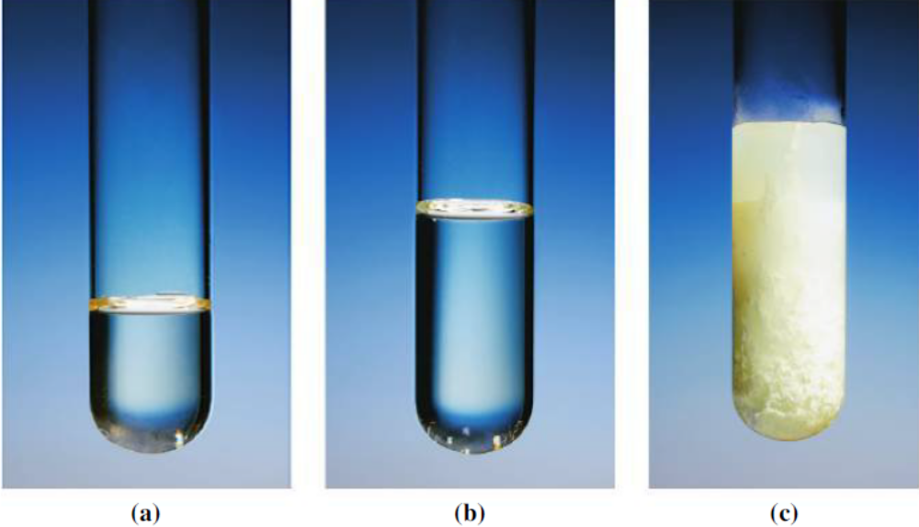
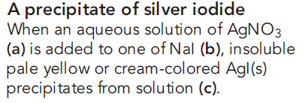
Predicting Precipitation Reactions
Suppose we are asked whether precipitation occurs when the following aqueous solutions are mixed.

Slide 15
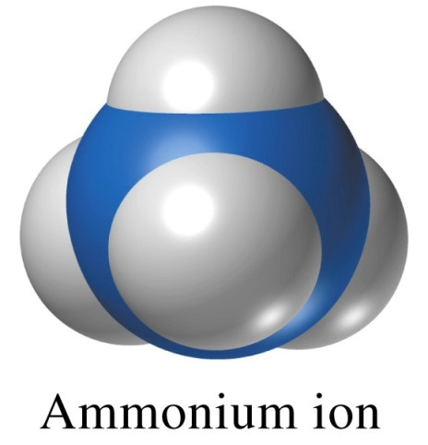
Solubility Rules
Compounds that are soluble:
  Alkali metal ion and ammonium ion salts
  Nitrates, perchlorates and acetates
Li⁺, Na⁺, K⁺, Rb⁺, Cs⁺ NH₄⁺
NO₃⁻ ClO₄⁻ CH₃CO₂⁻

Slide 16
Solubility Rules
Compounds that are mostly soluble:
  Chlorides, bromides and iodides Cl⁻, Br⁻, I⁻
    Except those of Pb²⁺, Ag⁺, and Hg₂²⁺.
  Sulfates SO₄²⁻
    Except those of Sr²⁺, Ba²⁺, Pb²⁺ and Hg₂²⁺.
    Ca(SO₄) is slightly soluble.

Slide 17
Solubility Rules
Compounds that are insoluble:
  Hydroxides and sulfides HO⁻, S²⁻
    Except alkali metal and ammonium salts
    Sulfides of alkaline earths are soluble
    Hydroxides of Sr²⁺ and Ca²+ are slightly soluble.
  Carbonates and phosphates CO₃²⁻, PO₄³⁻
    Except alkali metal and ammonium salts

Slide 18
5-3 Acid-Base Reactions
Latin acidus (sour)
  Sour taste
Arabic al-qali (ashes of certain plants)
  Bitter taste
Svante Arrhenius 1884 Acid-Base theory.

Slide 19
Acids
Acids provide H⁺ in aqueous solution.
first proposed by Svante Arrhenius in 1884.
Different acids exhibit different tendencies for producing ions in aqueous solution.
Strong acids:
Weak acids: reversible reaction
→
HCl(aq)
H⁺(aq) + Cl⁻(aq)
←
→
CH₃CO₂H(aq)
H⁺(aq) + CH₃CO₂⁻(aq)
Notes:
Chemistry 140 Fall 2002
Strong acids completely ionize in solution
Weak acids partially ionize in solution
Compare to the electrolyte strengths.

Slide 20
Bases
Bases provide OH⁻ in aqueous solution.
Strong bases:
Weak bases:
→
NaOH(aq)
H₂O
Na⁺(aq) + OH⁻(aq)
←
→
NH₃(aq) + H₂O(l)
OH⁻(aq) + NH₄⁺(aq)
Notes:
Chemistry 140 Fall 2002
Strong bases completely dissociate (or nearly so)
Primarily hydroxides of group 1 and some group 2 metals
Certain substances produce ions by reacting with water, not just dissolving in it.
NH₄ is a weak base because the eaciton does not go to completion.
MOST bases are weak bases

Slide 21
Recognizing Acids and Bases.
Acids have ionizable hydrogen ions.
  CH₃CO₂H or HC₂H₃O₂
Bases have OH⁻ combined with a metal ion.
  KOH
or are identified by chemical equations
Na₂CO₃(s) + H₂O(l)→ HCO₃⁻(aq) + 2 Na⁺(aq) + OH⁻(aq)
Notes:
Chemistry 140 Fall 2002
Ionizable protons are usually inidicated separately in a formula.

Slide 22
More Acid-Base Reactions
- Mg(OH)₂ is a base -quite insoluble
- a suspension in water that is the familiar milk of magnesia, used as an antacid.
- dissolve very slightly.
If an acid is added, H⁺ from the acid combines with this OH⁻ to form water-neutralization occurs. More Mg(OH)₂ dissolves to produce more OH⁻ in solution, which is neutralized by more H⁺ and so on. In this way, the neutralization reaction results in the dissolving of otherwise insoluble Mg(OH)_{2.}
Milk of magnesia Mg(OH)₂
Mg(OH)₂(s) + 2 H⁺(aq) → Mg²⁺(aq) + 2 H₂O(l)
Mg(OH)₂(s) + 2 CH₃CO₂H(aq) → Mg²⁺(aq) + 2 CH₃CO₂⁻(aq) + 2 H₂O(l)
Notes:
Chemistry 140 Fall 2002
Equation 1 is reaction with strong acid
Equation 2 is reaction with weak acid
Note the characteristic formation of water.

Slide 23
More Acid-Base Reactions
Limestone and marble.
Calcium carbonate, which is present in limestone and marble
CaCO₃(s) + 2 H⁺(aq) → Ca²⁺(aq) + H₂CO₃(aq)
CaCO₃(s) + 2 H⁺(aq) → Ca²⁺(aq) + H₂CO₃(aq)
But: H₂CO₃(aq) → H₂O(l) + CO₂(g)
CaCO₃(s) + 2 H⁺(aq) → Ca²⁺(aq) + H₂O(l) + CO₂(g)
CaCO₃(s) + 2 H⁺(aq) → Ca²⁺(aq) + H₂O(l) + CO₂(g)
The reaction is responsible for the erosion of marble statues by acid rain,
Notes:
Chemistry 140 Fall 2002
This equation shows CO₃2- acting as a base instead of OH-.
Our definition must be expanded from simple Arrhenius theory (Bronsted-Lowry and Lewis)

Slide 24

Limestone and Marble

Slide 25
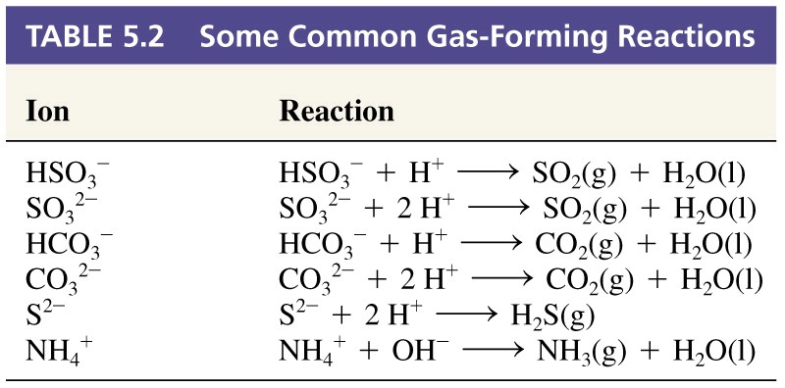
Gas Forming Reactions

Slide 26
5-4 Oxidation-Reduction: Some
General Principles
Practical applications of oxidation reduction reactions can be traced back thousands of years to the period in human culture when metal tools were first made.
The metal needed to make tools was obtained by heating copper or iron ores, such as cuprite (Cu₂O) or hematite (Fe₂O₃), in the presence of carbon.
Since that time, iron has become the most widely used of all metals and it is produced in essentially the same way:

Slide 27
5-4 Oxidation-Reduction: Some
General Principles
Hematite is converted to iron in a blast furnace.
Δ
Δ
Δ
Fe₂O₃(s) + 3 CO(g) → 2 Fe(l) + 3 CO₂(g)
Fe₂O₃(s) + 3 CO(g) → 2 Fe(l) + 3 CO₂(g)
Fe₂O₃(s) + 3 CO(g) → 2 Fe(l) + 3 CO₂(g)
Oxidation and reduction always occur together.
Fe³⁺ is reduced to metallic iron.
CO(g) is oxidized to carbon dioxide.

Slide 28
Oxidation State Changes
Assign oxidation states:
3+
2-
2+
2-
0
4+
2-
Δ
Fe₂O₃(s) + 3 CO(g) → 2 Fe(l) + 3 CO₂(g)
Fe³⁺ is reduced to metallic iron.
CO(g) is oxidized to carbon dioxide.

Slide 29
Oxidation and Reduction
Oxidation
  O.S. of some element increases in the reaction.
  Electrons are on the right of the equation
Reduction
  O.S. of some element decreases in the reaction.
  Electrons are on the left of the equation.

Slide 30
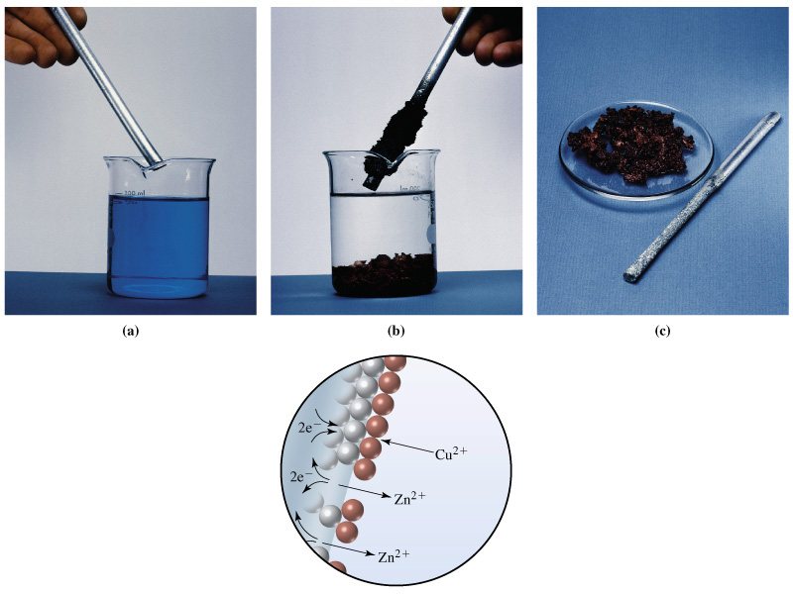
Zinc in Copper Sulfate
Zn(s) + Cu²⁺(aq) → Zn²⁺(aq) + Cu(s)

Slide 31
Half-Reactions
Represent a reaction by two half-reactions.
Oxidation:
Zn(s) → Zn²⁺(aq) + 2 e⁻
Reduction:
Cu²⁺(aq) + 2 e- → Cu(s)
Overall:
Cu²⁺(aq) + Zn(s) → Cu(s) + Zn²⁺(aq)

Slide 32
Balancing Oxidation-Reduction Equations
Few can be balanced by inspection.
Systematic approach required.
The Half-Reaction (Ion-Electron) Method

Slide 33
Example 5-6
Balancing the Equation for a Redox Reaction in Acidic Solution.
The reaction described below is used to determine the sulfite ion concentration present in wastewater from a papermaking plant. Write the balanced equation for this reaction in acidic solution..
SO₃²⁻(aq) + MnO₄⁻(aq) → SO₄²⁻(aq) + Mn²⁺(aq)

Slide 34
Balancing in Acid
Write the equations for the half-reactions.
  Balance all atoms except H and O.
  Balance oxygen using H₂O.
  Balance hydrogen using H⁺.
  Balance charge using e⁻.
Equalize the number of electrons.
Add the half reactions.
Check the balance.

Slide 35
Example 5-6
Determine the oxidation states:
4+
7+
6+
2+
SO₃²⁻(aq) + MnO₄⁻(aq) → SO₄²⁻(aq) + Mn²⁺(aq)
Write the half-reactions:
SO₃²⁻(aq) → SO₄²⁻(aq) + 2 e⁻(aq)
5 e⁻(aq) +MnO₄⁻(aq) → Mn²⁺(aq)
Balance atoms other than H and O:
Already balanced for elements.

Slide 36
Example 5-6
Balance O by adding H₂O:
H₂O(l) + SO₃²⁻(aq) → SO₄²⁻(aq) + 2 e⁻(aq)
5 e⁻(aq) +MnO₄⁻(aq) → Mn²⁺(aq) + 4 H₂O(l)
Balance hydrogen by adding H⁺:
H₂O(l) + SO₃²⁻(aq) → SO₄²⁻(aq) + 2 e⁻(aq) + 2 H⁺(aq)
8 H⁺(aq) + 5 e⁻(aq) +MnO₄⁻(aq) → Mn²⁺(aq) + 4 H₂O(l)
Check that the charges are balanced: Add e⁻ if necessary.

Slide 37
Example 5-6
Multiply the half-reactions to balance all e⁻:
5 H₂O(l) + 5 SO₃²⁻(aq) → 5 SO₄²⁻(aq) + 10 e⁻(aq) + 10 H⁺(aq)
16 H⁺(aq) + 10 e⁻(aq) + 2 MnO₄⁻(aq) → 2 Mn²⁺(aq) + 8 H₂O(l)
Add both equations and simplify:
5 SO₃²⁻(aq) + 2 MnO₄⁻(aq) + 6H⁺(aq) →
5 SO₄²⁻(aq) + 2 Mn²⁺(aq) + 3 H₂O(l)
Check the balance!

Slide 38
Balancing in Basic Solution
OH⁻ appears instead of H⁺.
Treat the equation as if it were in acid.
  Then add OH⁻ to each side to neutralize H⁺.
  Remove H₂O appearing on both sides of equation.
Check the balance.

Slide 39
5-6 Oxidizing and Reducing Agents.
An oxidizing agent (oxidant ):
  Contains an element whose oxidation state decreases in a redox reaction
A reducing agent (reductant):
  Contains an element whose oxidation state increases in a redox reaction.

Slide 40
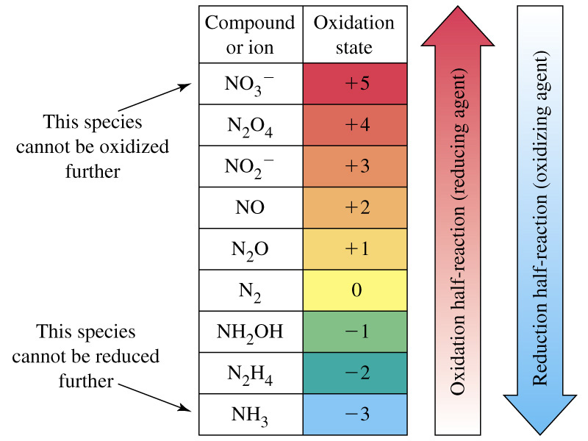
Redox

Slide 41
Example 5-8
Identifying Oxidizing and Reducing Agents.
Hydrogen peroxide, H₂O₂, is a versatile chemical. Its uses include bleaching wood pulp and fabrics and substituting for chlorine in water purification. One reason for its versatility is that it can be either an oxidizing or a reducing agent. For the following reactions, identify whether hydrogen peroxide is an oxidizing or reducing agent.

Slide 42
Example 5-8
H₂O₂(aq) + 2 Fe²⁺(aq) + 2 H⁺ → 2 H₂O(l) + 2 Fe³⁺(aq)
Iron is oxidized and peroxide is reduced.
5 H₂O₂(aq) + 2 MnO₄⁻(aq) + 6 H⁺ →
8 H₂O(l) + 2 Mn²⁺(aq) + 5 O₂(g)
Manganese is reduced and peroxide is oxidized.
Notes:
Chemistry 140 Fall 2002
Fe(2) is oxidized to Fe(3). Therefore peroxide is an oxidizing agent. Peroxide is reduced to water.
Mn(7) is reduced to Mn(2). Therefore peroxide is a reducing agent. Peroxide is oxidized to molecular oxygenl.

Slide 43
5-7 Stoichiometry of Reactions in Aqueous Solutions: Titrations.
Titration
  Carefully controlled addition of one solution to another.
Equivalence Point
  Both reactants have reacted completely.
Indicators
  Substances which change colour near an equivalence point.

Slide 44
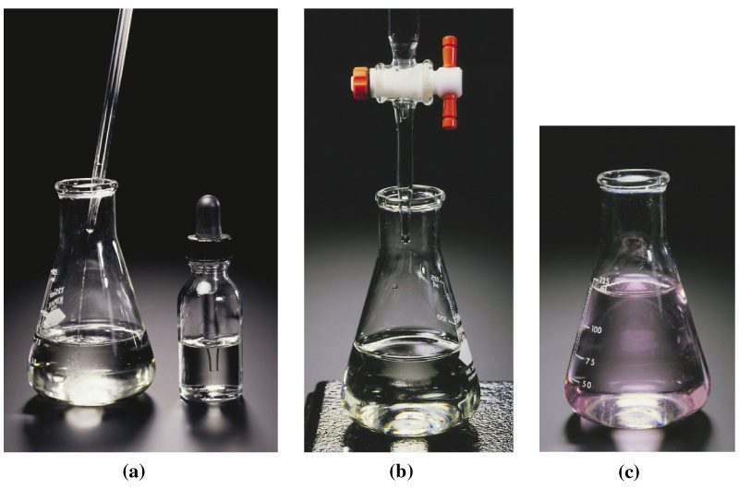
Indicators
A solution of one reactant is placed in a small beaker or flask. Another reactant, also in solution and commonly referred to as titrant, is in a buret, a long, graduated tube equipped with a stopcock valve. The second solution is slowly added to the first by manipulating the stopcock.

Slide 45
Indicators
Titration is a reaction carried out by the carefully controlled addition of one solution to another. The trick is to stop the titration at the point where both reactants have reacted completely, a condition called the equivalence point of the titration.
Key to every titration is that at the equivalence point, the two reactants have combined in stoichiometric proportions; both have been consumed, and neither remains in excess.

Slide 46
Indicators
Indicators
  Substances which change colour near an equivalence point.

Slide 47
Example 5-10
Standardizing a Solution for Use in Redox Titrations.
A piece of iron wire weighing 0.1568 g is converted to Fe²⁺(aq) and requires 26.42 mL of a KMnO₄(aq) solution for its titration. What is the molarity of the KMnO₄(aq)?
5 Fe²⁺(aq) + MnO₄⁻(aq) + 8 H⁺(aq) →
4 H₂O(l) + 5 Fe³⁺(aq) + Mn²⁺(aq)

Slide 48
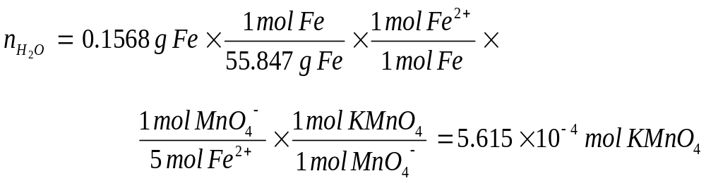
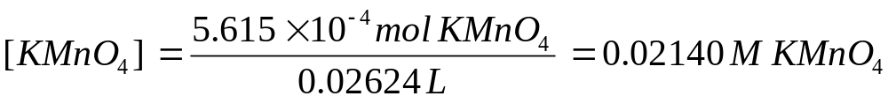
Example 5-10
5 Fe²⁺(aq) + MnO₄⁻(aq) + 8 H⁺(aq) → 4 H₂O(l) + 5 Fe³⁺(aq) + Mn²⁺(aq)
Determine KMnO₄ consumed in the reaction:
Determine the concentration:

